Slide 1
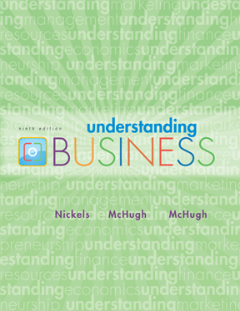
*
Chapter Two
*
Understanding How Economics Affects Business
McGraw-Hill/Irwin
Copyright © 2010 by The McGraw-Hill Companies, Inc. All rights reserved.

Slide 2
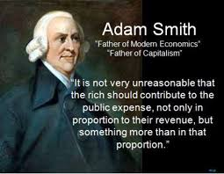

ADAM SMITH the
FATHER of ECONOMICS
*
Adam Smith & the Creation of Wealth
LG1
*
2-<number>

Slide 3

ADAM SMITH the
FATHER of ECONOMICS
*
Adam Smith & the Creation of Wealth
LG1
*
  Smith believed that:
    Freedom was vital to any economy’s survival.
    Freedom to own land or property and the right to keep the profits of a business is essential.
    People will work hard if they believe they will be rewarded.
2-<number>

Slide 4
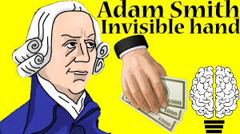
Invisible Hand Theory
*
Adam Smith & the Creation of Wealth
LG1
*
  The phrase invisible hand was introduced by Adam Smith in his book 'The Wealth of Nations'. ... He suggested that if people were allowed to trade freely, self interested traders present in the market would compete with each other, leading markets towards the positive output with the help of an invisible hand.
2-<number>

Slide 5
The INVISIBLE HAND THEORY
*
How Businesses Benefit the Community
LG1
*
As people improve their own situation in life, they help the economy prosper through the production of goods, services and ideas.
Invisible Hand -- When self-directed gain leads to social and economic benefits for the whole community.
Important Link: https://www.youtube.com/watch?v=NdUa2zrJL0g
2-<number>
Notes:
See Learning Goal 1: Explain basic economics.

Slide 6
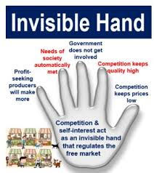
*
Adam Smith & the Creation of Wealth
LG1
*
2-<number>

Slide 7

UNDERSTANDING the
INVISIBLE HAND THEORY
*
How Businesses Benefit the Community
LG1
*
  A farmer earns money by selling his crops.
  To earn more, the farmer hires farmhands to produce more crops.
  When the farmer produces more, there is plenty of food for the community.
  The farmer helped his employees and his community while helping himself.
https://www.youtube.com/watch?v=vgK7LsWmWxI
https://www.youtube.com/watch?v=NdUa2zrJL0g
2-<number>
Notes:
See Learning Goal 1: Explain basic economics.

Slide 8

CORRUPTION DESTROYS ECONOMIES
(Making Ethical Decisions)
*
*
In many countries, a businessperson must bribe the government to gain permission to own land, build and conduct business operations.
Imagine you are a restaurant owner in need of a liquor license, but have been unable to get one. You know people in government. Would you be tempted to make large contributions to their re-election campaign to receive that license?
2-<number>
Notes:
See Learning Goal 1: Explain basic economics.

Slide 9
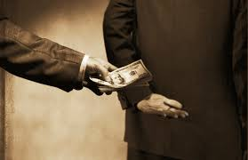
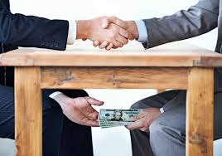
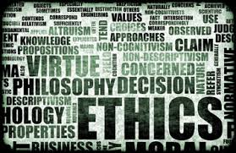
CORRUPTION DESTROYS ECONOMIES
(Making Ethical Decisions)
*
*
2-<number>
Notes:
See Learning Goal 1: Explain basic economics.

Slide 10
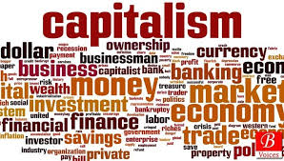
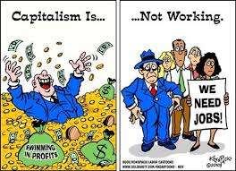
CAPITALISM
*
*
Capitalism -- All or most of the land, factories and stores are owned by individuals, not the government, and operated for profit.
2-<number>

Slide 11
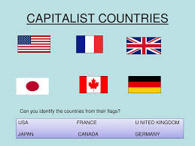
CAPITALISM
*
Understanding Free-Market Capitalism
Countries with capitalist foundations:
LG2
*
2-<number>

Slide 12
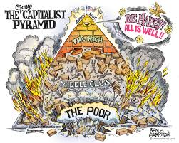
CAPITALISM’S
FOUR BASIC RIGHTS
  The right to own private property.
  The right to own a business and keep all that business’ profits.
  The right to freedom of competition.
  The right to freedom of choice.

Slide 13

FREE MARKETS
Free Market -- Decisions about what and how much to produce are made by the market.

Slide 14
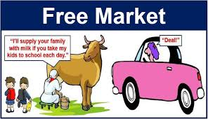

Slide 15
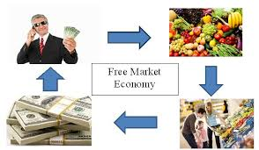
Consumers send signals about what they like and how they like it. Price tells companies how much of a product they should produce. If something is wanted but hard to get, the price will rise until more products are available.

Slide 16
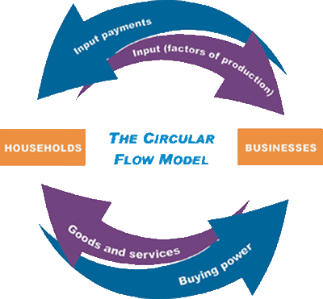
CIRCULAR FLOW MODEL
Important Link: https://www.youtube.com/watch?v=de3iGMjA_8c

Slide 17
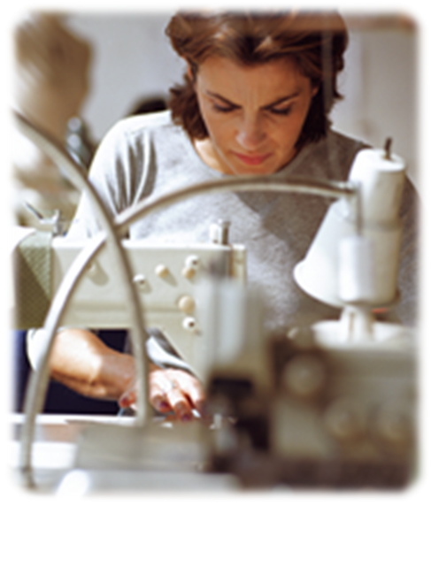
PRICING
    A seller may want to sell shirts for $50, but only a few people may buy them at that price.
    If the seller lowers the price to $30, more people buy the shirts.
    The seller establishes a price of $30 based on what consumers are willing to pay.

Slide 18
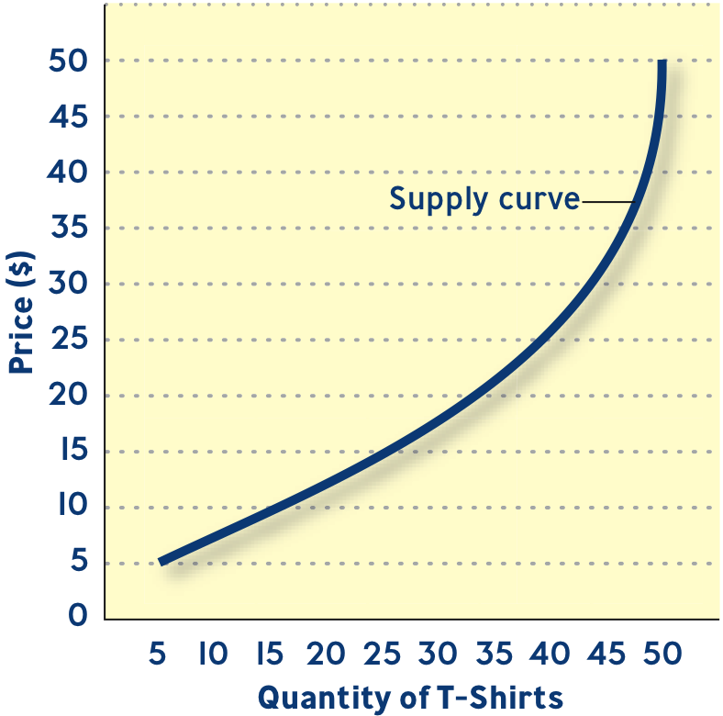
SUPPLY CURVES
Supply -- The quantities of products businesses are willing to sell at different prices.

Slide 19
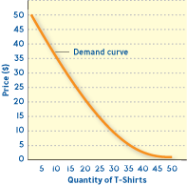
DEMAND CURVES
Demand -- The quantities of products consumers are willing to buy at different prices.

Slide 20
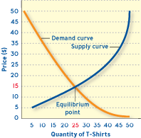
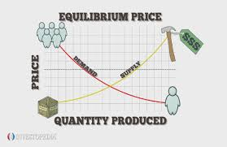
EQUILIBRIUM
Market Price (Equilibrium Point) -- Determined by supply and demand, this is the negotiated price.

Slide 21
Mini Activity:
What type of economic environment is present in Bangladesh?(Capitalism or Free market)
Justify your answer.

